Slide 1

Introduction to Debugging

Slide 2
Introduction
@ Instructor : Rahul Marathe[ Premier Field Engineer, Microsoft]
About You
Name, WinDbg Experience, Expectation
Logistics
Start & End Times :
Tuesday : 9 am CST – 5.00 pm CST
Wednesday : 9 am – 5.00 pm CST
Thursday 9 am CST – 2 pm CST
Lunch Break – 12 – 1 pm CST

Slide 3
Module Overview
Introduction to Debugging
Problems in Production
Challenges in debugging Production issues
Production Environment Debugging Timeline
Tools for .NET Debugging
Son of Strike (SOS)
Review

Slide 4
Demonstration: .NET Debugging Preview
In this demo, we’ll show you the power of .NET Debugging by introducing a problematic application and using several tools to diagnose, investigate, and determine the root cause of the issue.
Don’t worry too much about the detail now; this will be covered in depth during the course.
By the end of this course, you will have the knowledge that will allow you to perform the same root cause analysis on problematic .NET applications!

Slide 5
Different Software Environments
Developer’s machine
Functional testing
Integration testing
Performance and scalability testing
Staging
Production
Notes:
Question for the customer: what is the pahse of development? Do you have the same stages?
Question for the customer: how do you do troubleshooting when there is an issue in Production?
The staging server is a mirror of the production business management server.

Slide 6
Types of Problems in Production
System hang or deadlock
Fatal exception
Nonfatal exception
Data loss or inconsistency
Performance problems
Memory leaks or excessive memory usage

Slide 7
Causes of Problems in Production
Interaction with other systems
Hardware differences
Software differences
Unexpected load
Transient network conditions
Resource contention
Notes:
Resource contention: in testing there was one app/application pool but in production there are more applications contesting for the same app pool resources.

Slide 8
Challenges of Debugging in Production
Real users
Pressure to resolve quickly
Reluctance to ”make things worse”
Change control
Concern over tool installation

Slide 9
Challenges of Debugging in Production (Cont.)
Hard to access server
Can’t use normal tools
No repro
Infrequent problem
Hard to characterize problem
The problem only appears at a customer site

Slide 10
Tools and Environments
Least Invasive
Environment
Debugging tools
Production Staging Perf/scale test Integration test Functional test Development
Application logs
Perfmon
ADPlus
DebugDiag
WinDbg/CDB
MDbg
Visual Studio
Profilers
Most Invasive
Notes:
10

Slide 11
Tools Development Environment
The Visual Studio debugger is a managed, native, and script debugger
Can debug mixed-language solutions (C#, Visual Basic .NET, C++ .NET, and third-party languages)
Good for interactive debugging during development
VS2010 introduced the historical debugging concept (Ultimate SKU only)
Integrated support for profiling and unit testing (Visual Studio)

Slide 12
Tools Test/Staging Environments
Profilers
Visual Studio Profiler
CLRProfiler 2.0
Ants Profiler (3rd party)
Mem Profiler (3rd party)
NP Profiler
PerfView
Debuggers
WinDBG and CDB in conjunction with SOS
Used for both live debug and dump analysis
Notes:
CLR Profiler is not available for 4.0.
CorDbg, Mdbg managed debuggers, no post-mortem debugging.
MDBG is 2.0 and above only

Slide 13
Tools Production Environment
Diagnostics built into the application itself
Other tools
DebugDiag ( v 2.0 Update 2)
Runs as a service with a GUI front end
ADPlus
Automates console debugger CDB.exe
Performance Monitor
Diagnostic tool that gathers system and application performance data

Slide 14
Demonstration: Debugging tools
In this demo we will show you the tools mentioned in the previous slides.
Notes:
Demonstrate briefly the tools mentioned above.
Perfmon – show the most important counters

Slide 15
Production Debugging Timeline
Before a problem occurs
Pre-install debugging tools in production
Build symbols as appropriate
Build in application exception handling and logging
Design, build, and test for performance and scalability
Build in monitoring and diagnostics
Know the metrics of your system
Find and resolve problems before they become crises
Plan your deployments

Slide 16
Production Debugging Timeline (Cont.)
When a problem does occur
Don’t panic; be methodical
Evaluate the symptoms
Document what you do
Consider mitigation strategies
Gather data
After the problem has occurred
Analyze data
Plan and implement steps to resolve
Evaluate the improvement and repeat as necessary

Slide 17
Comparing Debuggers
 | Advantages | Disadvantages
Visual Studio 2010-2015 | GUI Source level debugging Familiar build in .NET debugging Edit & Continue | Large memory footprint Not a free tool Requires installation No Extension Support
WinDBG | GUI Source level debugging Designed specifically for debugging XCopy deployment Free tool | medium footprint limited .NET debugging with SOS or psscor extension
CDB | Command-Line Light weight Designed specifically for debugging XCopy deployment Free tool | No source level debugging limited .NET debugging with SOS or Psscor extension

Slide 18
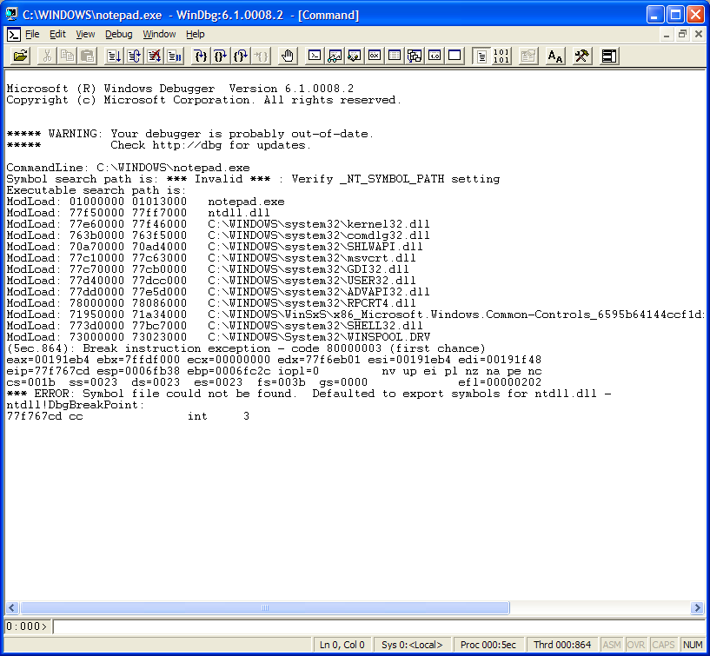
WinDBG outlook
Output Window
View Window Shortcuts
Tracing Shortcuts
Command Line
Current Thread #

Slide 19
Execution Control
Break
Ctrl+Break, or Menu: Debug -> Break
Go
g or F5 – continue execution
Step
p or F10 – Step Over
t or F11 – Step Into
Detach
q – Quit the debug session – it will terminate your application
qd – Quit the debug session with detach – the process won’t terminate

Slide 20
View Modules and Symbols
CDB and Windbg
LM – List loaded modules with source path
LMVM <module name> – List verbose module information
x command, used to examine modules, types,…
x Kernel32!Op* - list all symbols starting with “Op” in User32.dll
0:001> x kernel32!Op*
76d60964 kernel32!OpenProfileUserMapping
76cd1225 kernel32!OpenThread
..
Notes:
Lm options to demo
o Displays only loaded modules.
l Displays only modules whose symbol information has been loaded.
v Causes the display to be verbose. The display includes the symbol file name, the image file name, checksum information, version information, date stamps, time stamps, and information about whether the module is managed code (CLR). This information is not displayed if the relevant headers are missing or paged out.
1m Reduces the output so that nothing is included except the names of the modules.
sm Sorts the display by module name instead of by the start address.
X Command options
/0 Displays only the address of each symbol.
/1 Displays only the name of each symbol.
/p Omits the space before the opening parenthesis when the debugger displays a function name and its arguments
/a Sorts the display by address, in ascending order.
/A Sorts the display by address, in descending order.
/n Sorts the display by name, in ascending order.
/N Sorts the display by name, in descending order.

Slide 21
Verify and fix symbols
CDB and Windbg
Lml – Shows modules with loaded symbols
.sympath – displays current symbol path
To set symbols
- Use _NT_SYMBOL_PATH environment variable
- In WinDbg – use menu option File -> Symbol File Path
- In WinDbg use command
.symfix – to set the symbol server to Microsoft symbol server (http://msdl.Microsoft.com/download/symbols)
!sym –noisy – help debug symbol issues.

Slide 22
Breakpoints
Static (Fixed) Breakpoints
bp – set breakpoint
bu- set unresolved breakpoint
Conditional Breakpoints
Break at location if condition is true
bp MyFunction+0xb “j (poi(MyVar) > 0x20)”
Break at location if location == value
bp MyMod!myFunction “j MyMod!g_myGlobal == 1”
Break at location after count is reached
bp MyFunction+0xb 7
Notes:
With bp breakpoint can be sent at any address that is an instruction example show breakpoint @ basicTypes function, using uf unassemble the function and set the breakpoint at dword ptr [ebp-54h],offset HelloCpp!`string' the last code instruction.

Slide 23
Breakpoints (continued)
Execute debug statements when breakpoint is reached
bp MyFunction+0xb “kb;.frame 2;dv;g”
Others
bu Breakpoint unresolved
can be set on modules which are not loaded right now
gets resolved when module loads
stores Breakpoint in the Workspace
bl – list breakpoints
bd – disable breakpoint
be – enable breakpoint
bc – clear breakpoint
bd * - disables all breakpoints
bd 3 – disables Breakpoint 3

Slide 24
Thread Commands
~. : Current Thread
~# : Display thread caused exception
~5 : Display Thread 5 can be 0...Thread Count-1
~5s : Set Thread 5 to be the current one
~*: All Threads
Example: Display the call stack for all threads ~*kb

Slide 25
Call Stacks
CDB/Windbg k command with several options
Display of calls and arguments
kn – include frame numbers
kb – include first three parameters
kd – display raw stack data
kp – gives detailed symbol information about parameters
kL – display without source lines
Notes:
For Demo attach debugger to NativeExceptions.exe; set a break point at ComDllWithException!CExceptions::CppEx
A stack, as related to executing code in Windows, is simply just a block of memory assigned by the operating system to a running thread. The purpose of the stack, among other things, is to track the function call chain (allocation of local variables, parameter passing, and so on).
Hewardt, Mario; Pravat, Daniel (2007-10-29). Advanced Windows Debugging (Kindle Locations 3932-3933). Pearson Education. Kindle Edition.

Slide 26
Navigating on a Thread
Change frames
.frame <frame number>
View Local Variables (*)
dv – display locals (Alt+3)
dt – displays information about
Variables (local/global) or
datatype
*need private symbols
0:000> dv
hInstance = 01000000
hPrevInstance = 00000000
lpAnsiCmdLine = 00091eeb ""
cmdShow = 0xa
msg = tagMSG
lpfnRegisterPenApp = 00000000
Notes:
How to public private and public symbols ?

Slide 27
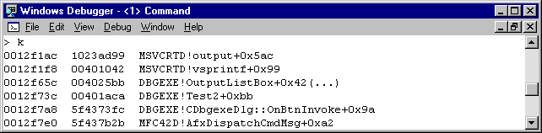
Call Stacks – examples
K Command
OutputListBox has a variable number of arguments: (..)
Return address
poi(ESP)
Notes:
OutputListBox has a variable number of arguments, therefore (..)
The call looks like:
OutputListBox(TEXT("TEST2:[%s]"),pszFileName);

Slide 28
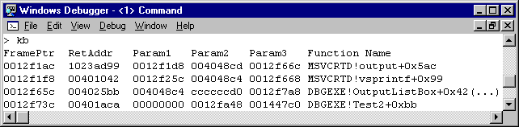
Call Stacks – examples
what are the arguments?
KB Command –displays the first 3 Arguments ->DWORDs on the stack

Slide 29
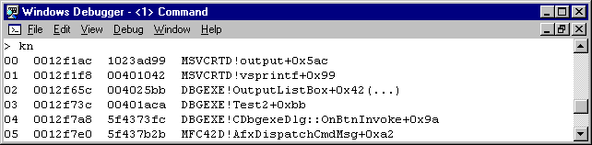
Call Stacks – examples
KN adds the frame number to the display
options can be chained together to get the desired results.
not presented

Slide 30
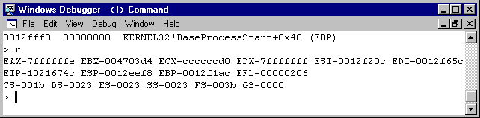
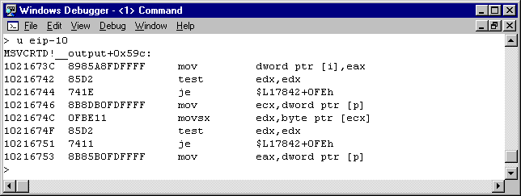
View Registers and Assembly
View Registers R command – CDB/Windbg
Disassembly
U <address>
Uf <function>
not presented

Slide 31
Examine/Modify Memory
d commands – display address or address range
dd – display double words (DWORDS/4 bytes)
dc – display double words and ASCII values, poi(char* address)
da – display ASCII value
du – display Unicode value
dp – display pointer (64Bit on 64Bit target)
ed – edit memory (ex. ed 0x23478924 10)
? – expression evaluator, ?n0 converts decimal to Hex
0:000> ?10
Evaluated expression: 16 = 00000010
Notes:
?Show both decimal to hex and hex to decimal conversions
The default count for dd is 32 DWORDs (128 bytes).
Show additional commands like db : for the character values “Rahul Marathe”

Slide 32
Set Exceptions
Controls debugger actions when an exception occurs
sxe – enable
sxd – disable
sxi – ignore
sxn – notify
Types of events to handle
sxe ld – break when a module loads
sxn av – notify (don’t break) on Access Violations

Slide 33
Debugger Log File Commands
CDB/Windbg
Logfile Open/Close/Append
Add comments
.logopen [filename] //open a new log file
.logappend [filename] //appends to an existing log file
.logclose //close current log file
* [comment] // Used to add a comment
.echo [comment] // Will echo back what you type
not presented
Notes:
Usage Analysis Problems and Solutions
The goal is to produce Usage Reports based on data from logs written by various servers (HTTP servers, streaming media servers such as RealAudio, and proxy servers). The problem is well suited to database technology, so the architecture includes the Analysis Database. The database is created during Site Server setup, if the administrator chooses the default database option (Microsoft Access). If the administrator chooses Microsoft SQL Server, the setup program does not create the database, and the administrator should use the Database Setup Wizard. When that wizard finishes, the Analysis Database contains various blank tables for usage data, and populated tables of reference data. To add log files to the database, the administrator runs the Usage Import tool. That tool's main job is parsing log files and adding content to the database, but during the parsing process it keeps track of frequently-requested totals, such as the number of visits, and it presents these import statistics at the end of the import process. In order to generate reports, the user runs the Report Writer tool.
Interse's MarketFocus product was the basis for the usage analysis tools.

Slide 34
SOS: Not Just a Call for Help
SOS.DLL
debugger extension used to debug managed code
E.g. debuggers: WinDBG/CDB
To use SOS in WinDBG, use .loadby command
.loadby sos mscorwks – .NET 2.0, 3.0 & 3.5
.loadby sos clr – .NET 4.0 (New!)
To use SOS in Visual Studio
Use the .load <FullPath> in the Immediate Window
Version to use and method of loading may vary depending on situation and version of .NET Framework being debugged

Slide 35
Post-Mortem Managed Debugging
What do you need to debug managed dumps?
SOS extension
.NET 1.x
SOS ships with windbg
No other DLL required
The framework is not required on the debugger machine
.NET 2.0/4.0
SOS ships with the framework
Require mscordacwks.dll – this must be the same version as on the machine where the dump was taken
Otherwise you get error message when running any SOS commands

Slide 36
Common SOS commands
!threads – listing the managed threads
!ThreadPool – Displays information about managed thread pool
!clrstack – listing the managed callstack of the currently active thread
!uniqstack – List only unique stack
!dumpstackobjects – listing the managed objects on the stack
!dumpheap – provides information about the objects on the heap
!dumpobj <object address> - dumping out the content of an object
!bpmd – Set managed breakpoint
Notes:
!threads - [-live] [-special]
~*e!clrstack
!threadpool
DumpHeap [-stat] [-strings] [-short] [-min <size>] [-max <size>] [-type]
ObjSize [<Object address>] | [-aggregate] [-stat]
!bpmd NetDebugDemos.exe NetDebugDemos.SOSBasics.ManagedBreakpoint
TO DO
!objsize – Display size of an object or type
.foreach – Iterate over a list; execute additional command(s) for each item

Slide 37
Common SOS commands
!DumpStack – Display stack trace, similar to k command on x64
!EEStack - Display stack on all threads
.chain– Shows extension that are loaded
!EEVersion – Shows .Net Version and SOS Version
Version Commands
Version – Version of debugger
Vertarget – Version of the target computer
!sos.Help – Shows commands in an extension like SOS
Notes:
~*e!clrstack
!threadpool

Slide 38
Demonstration: WinDbg and SOS
The instructor will demonstrate some of the basic steps to execute when analyzing a managed application with WinDbg and SOS.
Notes:
+ Demonstrate how to load SOS in Visual Studio.

